Slide 1
Approximating Nash Equilibria for Black-Box Games: A Bayesian Optimization Approach
Abdullah Al-Dujaili, Erik Hemberg, Una-May O'Reilly
aldujail@mit.edu
Notes:
Hello everyone, my name is Abdullah, I am a postdoc at the ALFA group, from CSAIL, MIT. This is a joint work with Erik Hemberg and Una-May, Our group is broadly interested in problems in the field of healthcare, education and cybersecurity, which is the motivation for this paper.

Slide 2
Motivation
Cybersecurity Application: Computer Network Security
Noisy Simulation model for attacker-defender engagement
Continuous (real-valued) actions (e.g., budget allocation)
Expensive running time (simulation run ~ 10 seconds)
Compute Pure Nash Equilibrium (PNE) or an approximate
Hemberg et al. "Adversarial co-evolution of attack and defense in a segmented computer network environment." GECCO, 2018.
Notes:
Where we work with simulation models for computer network security capturing engagement between defenders and attackers in the network. The values returned are noisy versions of the payoff functions of the players. Their action space is continuous (budget allocation). Every simulation run takes around 10 second for one engagement evaluation. So to understand this arms race. We are interested in computing Nash Equilinrium or an approximate of it.

Slide 3
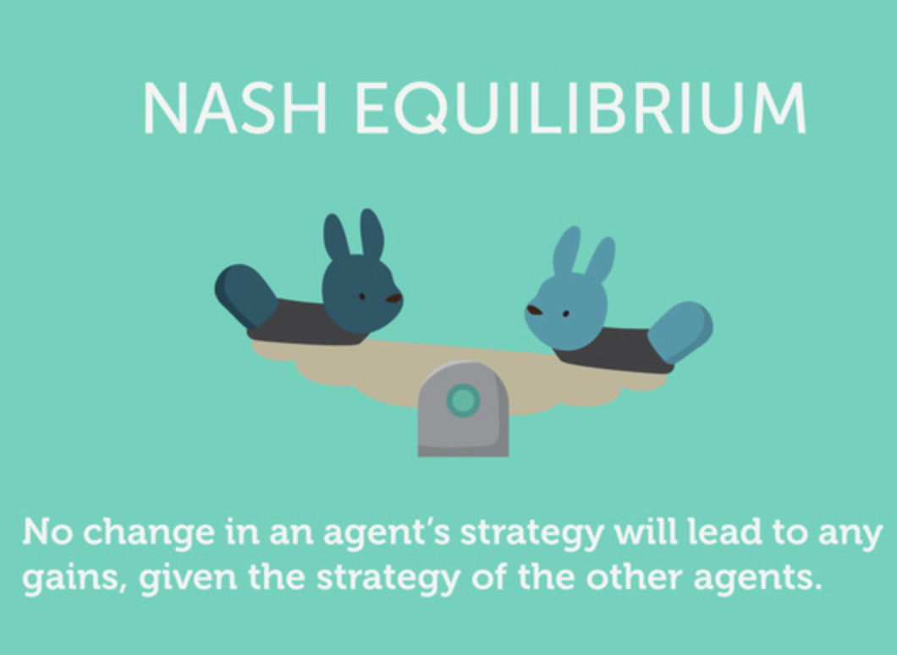
Courtesy of UPSE
Notes:
I am sure almost everyone in this room knows about Nash Eq. which is a condition where no agent is incentivized to change his/her actions given the actions of the other players.

Slide 4
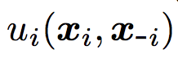
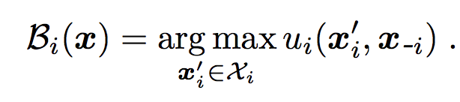
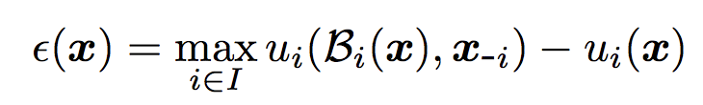
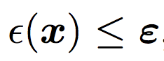
NE : Game-Theoretic Regret View
i’s payoff
i’s best response
Game-theoretic regret
A profile x ∈ X is an ε-NE if and only if
Notes:
It can be described through the lens of game-theoretic regret. So you have the players payoff and given the other player’s action (x_i) you can compute the best response. So the difference between the payoff values is called the game-theoretic regret and Nash Equilibrium is a point whose regret is zero.

Slide 5

Game Theory
Framework for modelling a wide range of multi-agent scenarios.
Many algorithmic solutions require
discrete, finite games
closed-form specification of payoffs
Courtesy of UPSE
Notes:
Nash equilibrium has been studied extensively by the game theory community. But many algorithmic solutions requires discrete finite games and closed-form specification of the payoffs.

Slide 6
Expensive Black-Box Continuous Games
Continuous:
player i’s actions are real-valued vectors.
Black-Box:
Games constructed from empirical observations of strategic play.
Observations agent-based simulation, real-world data
Expensive:
oracle call ~ O(hour) [Wellman et al., 2005]
Notes:
Which is different from our setup. Our setup in Expensive Black-Box Continuous Games

Slide 7
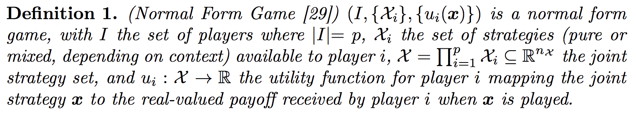
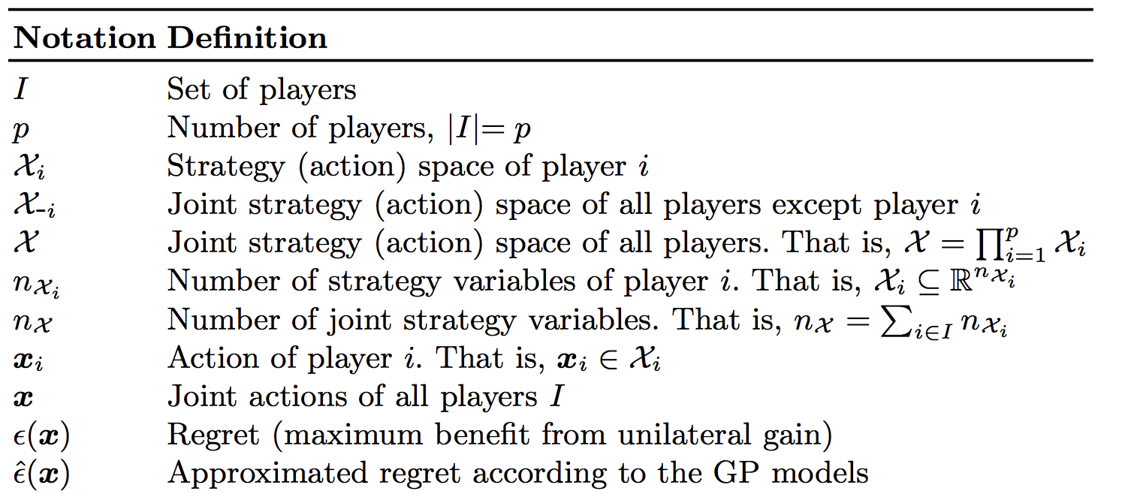
Notation

Slide 8
Related Work
Continuous Games:
coarse discretization amenable to finite-game solvers [Kroer et al., 2015].
Black-Box Games:
Supervised learning methods for learning players’ payoffs [Vorobeychik et al.,2007]
NE: Hierarchical Simulated Annealing to minimize the regret [Vorobeychik et al.,2008] (requires many samples)
Expensive Games:
coarse discretization of the action space with Bayesian Optimization: measuring the probability of equilibrium [Picheny et al., 2018] .
Notes:
And so I’ll briefly describe related work

Slide 9
Related Work > Our Proposition
Continuous Games:
coarse discretization amenable to finite-game solvers [Kroer et al., 2015].
Black-Box Games:
Supervised learning methods for learning players’ payoffs [Vorobeychik et al.,2007]
NE: Hierarchical Simulated Annealing to minimize the regret [Vorobeychik et al.,2008] (requires many samples)
Expensive Games:
coarse discretization of the action space with Bayesian Optimization: measuring the probability of equilibrium [Picheny et al., 2018] .
Notes:
So here in our work, we wanted to break away from this discretization, and our approach can be described as a hybrid of these methods.

Slide 10
Our Proposition
Gaussian Processes (GP) to jointly
Learn the payoffs
Approximate the regret
Minimize the regret
Notes:
We propose to use Gaussian Process to jointly learn the payoffs, approximate the regret and minimize it.

Slide 11
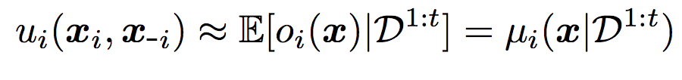
Our Proposition
Gaussian Processes (GP) to jointly
Learn the payoffs (maximize the observations’ loglikelihood)
Approximate the regret
Minimize the regret
Notes:
By learning the payoff, we fit the joint gaussian distribution over the observed values such that we maximize the loglikelihiood

Slide 12
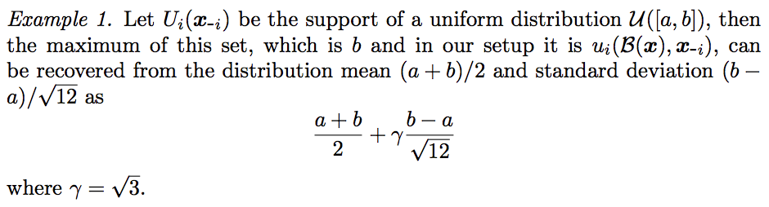
Our Proposition
Gaussian Processes (GP) to jointly
Learn the payoffs
Approximate the regret
Minimize the regret
Notes:
Recall that Nash Equilibrium corresponds to zero regret. So the problem of looking for nash equil. This is a nested optimization problem. Instead we propose to straighten it out making use of GP. Consider the motivationting example. Suppose that payoff values of player i given fixed actions of the other players comes from the uniform distribution, then the max of these values which b in this case can be described as sum of its mean and the standard deviation scaled by gamma

Slide 13
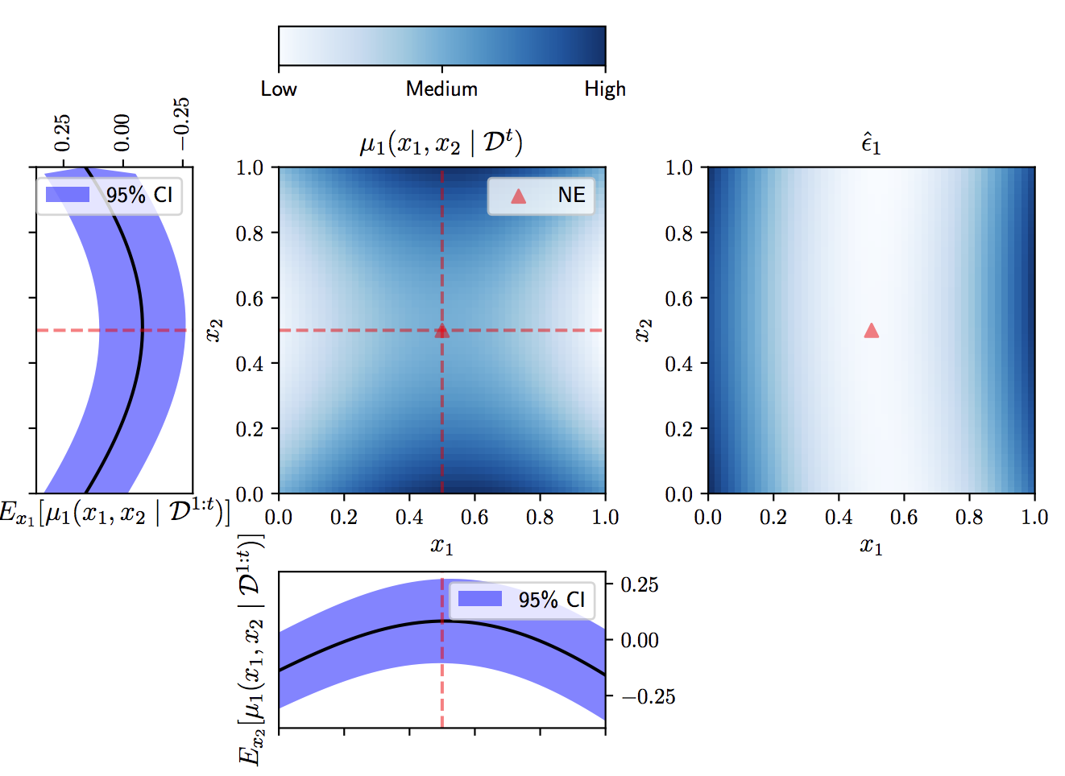
Our Proposition
Gaussian Processes (GP) to jointly
Learn the payoffs
Approximate the regret
Minimize the regret
Recall

Slide 14
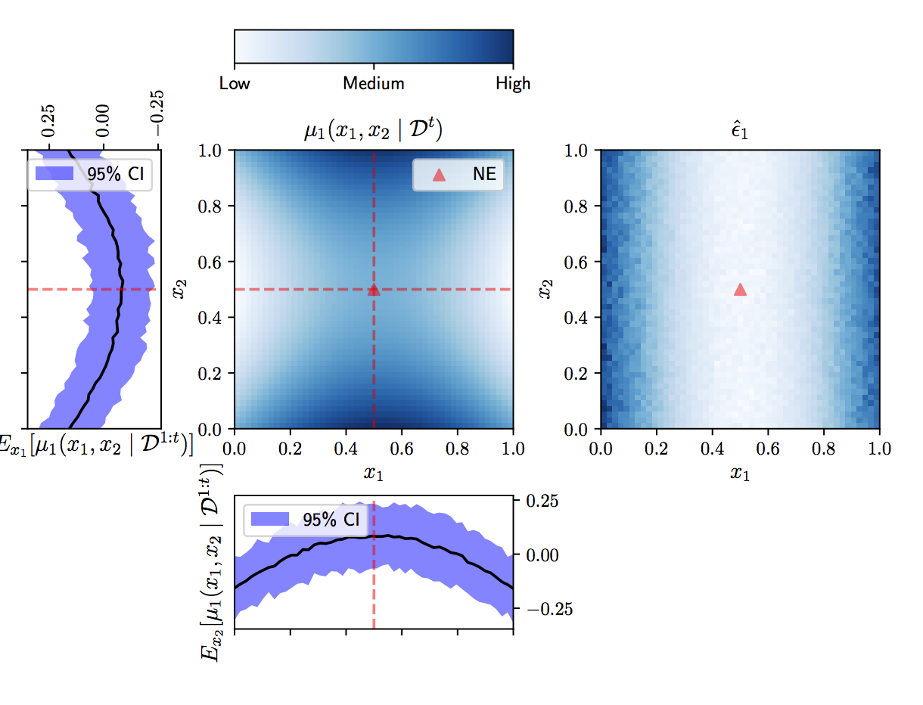
Approximated Regret – Analytical vs. Approximated
Notes:
This regret approximation can be computed exactly or estimate with sampling.

Slide 15
Our Proposition
Gaussian Processes (GP) to jointly
Learn the payoffs
Approximate the regret
Minimize the approximated regret (use any of off-the-shelf black-box solvers)
Notes:
With this approximation at hand,

Slide 16
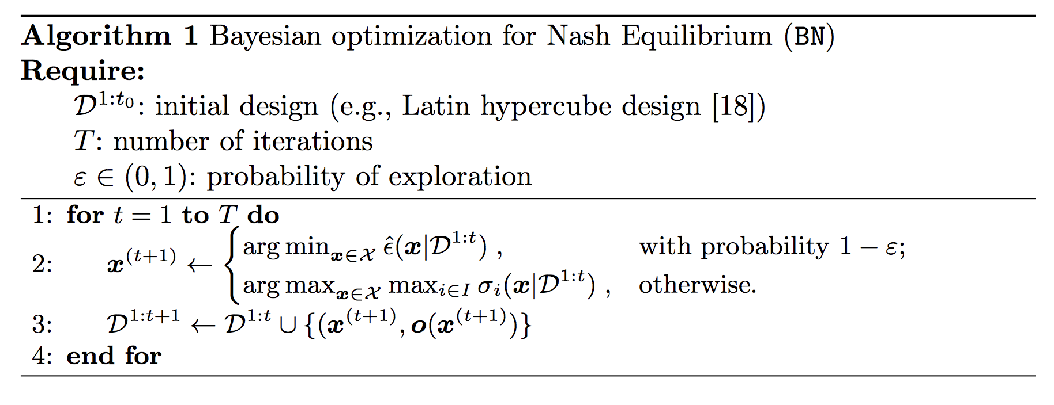
Our Proposition
Gaussian Processes (GP) to jointly
Learn the payoffs
Approximate the regret
Minimize the regret
Notes:
In summary this is the algorithm.

Slide 17
Demo Time!
Code @ https://github.com/ALFA-group/bayesopt-nash-eq

Slide 18
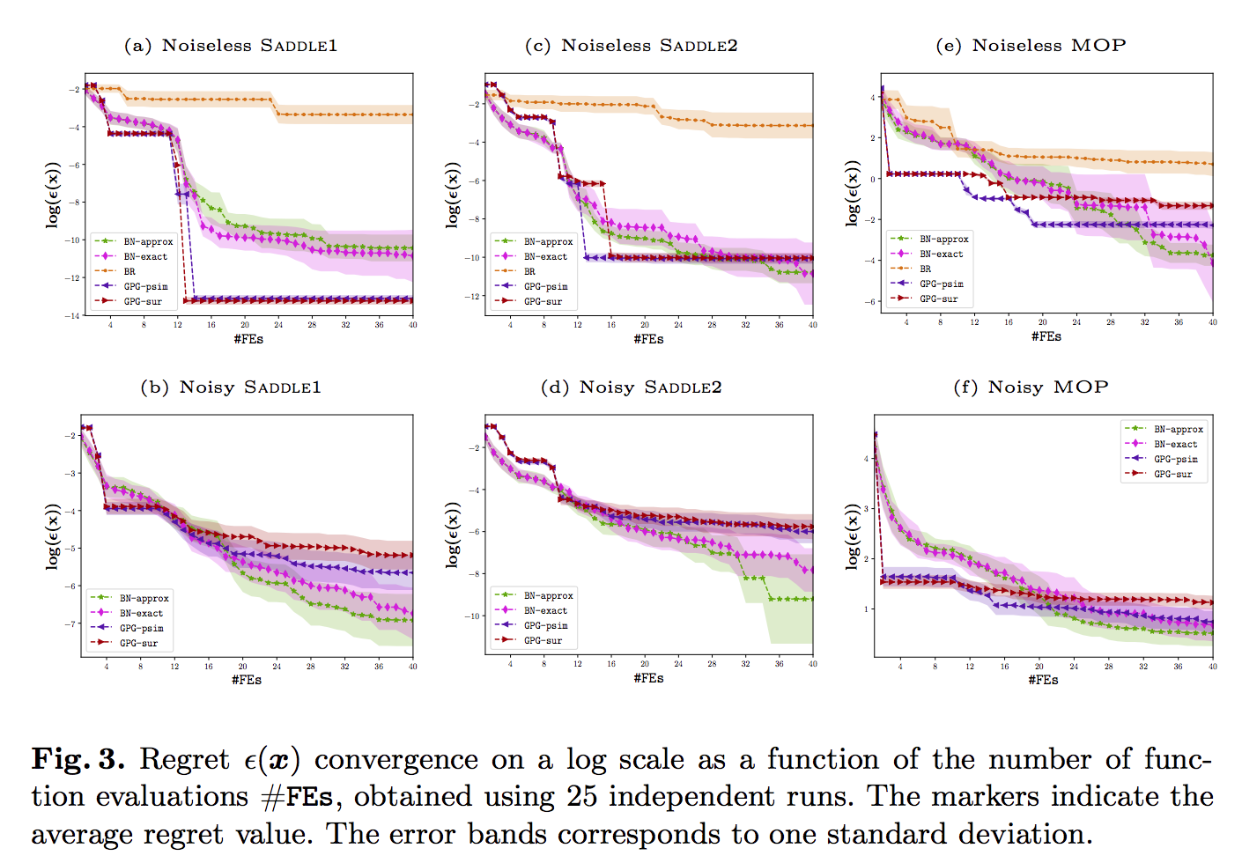
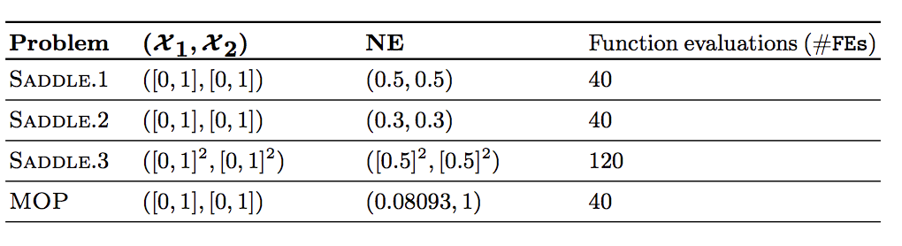
Experiments

Slide 19
Future Work
Cybersecurity Application
Scalability
Computational Complexity O(n^3)
Higher Dimensions
Model Overfitting

Slide 20
